Slide 1
Technology and Collaboration: A Call to Action, Together!
November 4, 2015
Presented by Janhavi Kirtane
Director, Collaborative Health Network
Network for Regional Healthcare Improvement

Slide 2
Aims
Make the case why you (and your organizations) should think about technology and collaboration
Provide an overview of the functionality and design of the HealthDoers Open Community
Answer your questions and get your feedback so we can get started!

Slide 3
It’s Nice to Meet You!
Joined the Network for Regional Healthcare Improvement (NRHI) in 2014 to lead the Collaborative Health Network, launched with the support of the Robert Wood Johnson Foundation
Worked for the federal government from 2009-2014 based out of the Office for the National Coordinator for HIT
Acting Director/Dissemination lead for the Beacon Community Program
Member of the HHS Partnership for Patients working group, focusing on care transitions
Working on CMMI Health Care Innovation Awards
Spent 10 years working as a private sector strategy consultant for hospitals and healthcare systems
“The world doesn’t change one person at a time. It changes as networks of relationships form among people who discover they have a common cause and vision of what is possible. It is critical connection, not critical mass.” Margaret Wheatley

Slide 4
How Can Technology Accelerate Collaboration?
Moving knowledge Management to “Social Learning”
Best practice and Lessons Learned

Slide 5
Technology + Collaboration = ?

Slide 6
Technology + Collaboration = ?

Slide 7
Why do we need to be online?
We recognize the value of in-person convenings to build trust and forge new connections.
But, we are not together all the time, do not always know who in our network might have the answers and guidance we need, and we may not always have opportunities for rising stars to meet and engage with their peers.
“Social tools leave a digital audit trail, documenting our learning journey - often an unfolding story - and leaving a path for others to follow.”
“…online communities are most useful when they address failures in the operation of offline communities.”
From The New Social Learning by Bingham and Conner

Slide 8
Online Knowledge Management Vs. Social/Collaborative Platforms – We Need Both!
✓
✓
Knowledge Management
Social/Collaborative Platforms
Storage of files
Centralized organization of materials
Emphasis on finished products and content
Technology to support organization of specific materials
Unintended consequence: networks tied to content may not have a home post program
Ex: Beacon, AF4Q and many others
Post, comment, “like” – finished or unfinished content
Emphasis on relationships as a way to get information
Teach all, learn all – knowledge is everywhere
Technology to support capture of insights/questions as you go, collaboration, and links to people
Unintended consequence: technology could seem like too much of a commitment

Slide 9
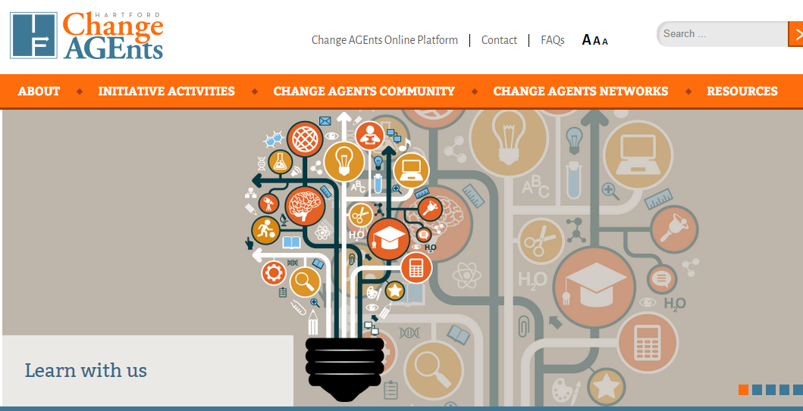
We’re Seeing the Shift Happen as Corporations Seek to Tap Into Depth of Knowledge and Wisdom in their Ranks…and it’s coming to Healthcare Improvement!
This is quickly evolving space, there is no one solution or vendor that is doing this perfectly, but a convergence on an agreed upon set of functions that work well for people: Facebook functionality (posting, commenting, liking), calendars, search, directories.

Slide 10
The Collaborative Health Network provides trusted peer-to-peer forums and programming to support “HealthDoers” working to improve community health and healthcare. The Robert Wood Johnson Foundation selected the Network for Regional Healthcare Improvement to launch this initiative to ensure that a broader network of individuals and organizations learn about and apply the multi-stakeholder approach, so that no one has to start from scratch. The online and in-person offerings of the Collaborative Health Network are designed to rapidly identify and spread what works, foster meaningful connections, and build upon existing efforts. Participant feedback and energy directly inform network priorities and offerings. Join the Collaborative Health Network by visiting www.healthdoers.org and follow #healthdoers on twitter.

Slide 11
The Foundation of the Collaborative Health Network is the HealthDoers Platform
Sharing
Library
Calendar
Like/Comment

Slide 12
HealthDoers Open Community Overview – Major Topics and Groups (so far – evolves based on interest)
Transparency
Expert library
News and updates about transparency
Center for Healthcare Transparency
Discussion group for Wellville 5
Curated resources
AF4Q alumni
Upstream/multi-sector programs
HealthDoers
Open Community
Community Programs
Total Cost of Care
Lessons learned
Resources
Public group of grantees
Collaborative Leadership & Stewardship
Payment Reform
LAN echo partner
Regional experiences
Affinity group(s)
Expert libraries for resources
Don’t Start from Scratch
Consumer Engagement
Patient engagement
Consumer involvement in boards
AF4Q lessons learned
Tools and resources
Funding announcements
Experts you should know about

Slide 13
Collaborative Health Network Vision: Provide a broader platform for connection and learning across the ecosystem
Wellville
HealthDoers
Open Community
(Open to All)
AF4Q Alumni
Choosing Wisely
100 Million Healthier Lives
NRHI Member Community
Iowa HEN-HUB
And MORE!
Notes:
AFTER DEMO: What niche might this fill for you?
Lead group discussion (just them talk and brainstorm) about the AF4Q consumer group to date – what do they want to continue? How can we support them? Explain how we empower them to use the tools we offer to continue the work. (collaboration folders; libraries; ZOOM meetings; coffee chats; bring in experts;)

Slide 14
Lesson 1 - Keep it Simple: This Cannot be One More Thing or Technically Overwhelming (Cue the Community Manager!)
Connect the on-line with the in-person (or virtual programming – today!) by posting meeting materials, follow up questions etc.
Don’t try to replace something that works IRL with something online
Reduce technical confusion – let’s start with some basic options
Create habits with a steady cadence, e.g., weekly email every Thursday, topic prompts, webinars
Support and nurture those who are most comfortable, but also figure out how to make it interesting and required to show up, i.e., exclusive expert commentary, the go-to place for materials, etc.

Slide 15
Lesson 2 - Love your lurkers and your contributors!
Jakob Nielsen’s 1-9-90 Rule
With good community management, this portion grows > 25-30% and lurking shrinks
Still find value in what they read and learn!

Slide 16
Lesson 3 – Technology works for different personas in different ways and EVEYRONE has a role to play
A note about the picture: MailChimp, the email marketing product, has an “ideal customer archetype” (bottom left). We would argue, everyone has a role to play – we just have to find the right match!
Source: http://blog.mailchimp.com/new-mailchimp-user-persona-research/ by MailChimp’s DesignLab.

Slide 17
Lesson 3 - These types of online communities work for different personas in different ways and EVEYRONE has a role to play
Example Roles | Persona | Expectations
Host | Emotionally connective, likable Caring and nurturing | Welcomes visitors Makes introductions Responds quickly to posts that have been made Builds robust community knowledge about people, projects, etc., so that they can rapidly connect the posts/people Get groups started
Topic Expert | Confident Focuses on content over relationships | Creates long-form content to spark conversations Posts critical thought leadership pieces Respond to other people’s opinions and critical questions Featured on webinars or pulled in to groups for certain discussions
Librarian | Organized, detail-oriented | Knows where to find resources to keep the conversation informed Answers questions with references to resources
Community Managers AND Ambassadors | Confident Determined Has a belief in the mission | Offers constructive feedback on technology and processes Gracefully diffuses any community negativity Tries to model and celebrate desired behaviors

Slide 18
Lesson 4 – The “perfect” online system doesn’t exist AND we all want slightly different things (so start and do the PDSAs)
Match.com or Angie’s List for healthcare improvement
Can’t we do this on Facebook/I am not using Facebook for work
Can’t we do this on Linked in/I don’t like Linked in
A directory of people and programs
A wikipage
A smart listserve/Keeping this on email will help
A searchable best practice library
A site that blends data, our own QI and online communities
And more…
I

Slide 19
Lesson 5 – Be patient on metrics and combine the stories with the data (Two perspectives)
From Community Roundtable
Anecdotal
Basic activities
Activities and content
Behaviors and Outcomes
Excitement after launch!
Conversations with ambassadors
Logging in and creating profile
Creating posts
Following topics
Align operations with platform
Engaging content growing in specific areas
Ambassadors/ top posters becoming established
Begin to see how sharing content leads to improvement or saved time
Rhythm of activities is known and observable
Pirate Metrics from Dave McClure (AARR)
Acquisition
Activation
Retention
Referral
Total invite #
Invite → sign-up page conversion
#profiles completed
# of first posts/comments
Frequency of visits
Length of visit
User to user referrals

Slide 20
HealthDoers Open Community Walk Through
Now let’s go to the JOIN page
Should receive via email post conference

Slide 21
HealthDoers Open Community Walk Through
http://healthdoers.bravenew.com/
Bookmark this Page!

Slide 22
Questions? Thank you!
Walk through of the Open Community and more orientation videos: https://vimeo.com/134324003
Do you want to chat, share ideas? Are you excited? Please reach out at jkirtane@nrhi.org
Issues or questions? healthdoers@nrhi.org
Can’t wait to read more?
Online Community Strategy Framework, Lauren DeLong
Online Community: Heart of Social Strategy, Lithium
The Ultimate Framework for Planning an Online Community Strategy, Socious
Community Maturity Model, The Community Roundtable
Blogs to read, The Community Roundtable

Slide 23
HealthDoers Open Community Walk Through - Vimeo
..\Desktop\FAST TRACK Collaborative Health Network Orientation-HD (1).mp4/
Bookmark this Page!

