Slide 1
Models of Engagement for Patients and Families
Nancy D. Zionts, MBA
COO/Chief Program Officer
Jewish Healthcare Foundation

Slide 2
Mission: To galvanize a powerful coalition of women’s networks to develop sustainable means to change women’s behavior and women’s heart health outcomes
Who: A coalition of over 60 organizations initiated in February, 2002
Why: Heart disease is the #1 killer of women, but less than one-third of women know that fact --- then
What: Increasing Awareness, Changing Lifestyles
Engagement at multiple levels:
Communities: You have a leadership role and assets to contribute
Women: You Can Take Control of Your Heart Health!

Slide 3
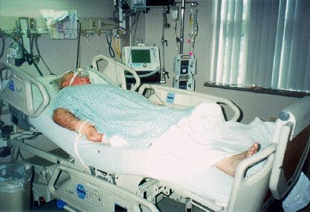
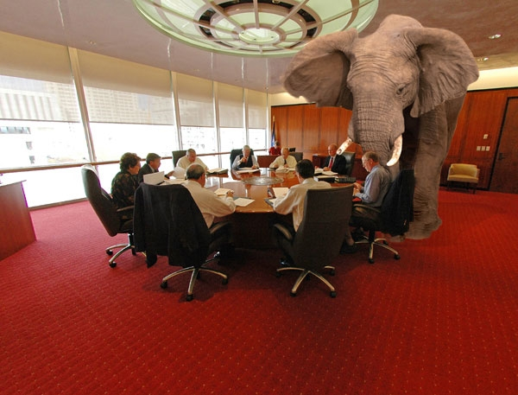
We brought together “community “
-- not just healthcare, not just experts
Facilitated multiple cycles of a six part series of Community Conversations that features Family and Caregivers
Focus: how people experience the system and how they want to change the default options
Notes:
At the Jewish Healthcare Foundation we have become somewhat fixated on the fact that the healthcare system too often fails families and patients at end of life. End of life care presents emotional, physical and financial burdens for patients and their loved ones. This is what we have come to expect at end of life. But, we believe other realities are possible.

