Slide 1
South County Health
Washington County Coalition established 1/2011
Lynne Driscoll RN, CCM,CPHM
Director of Case Management
South County Hospital

Slide 2
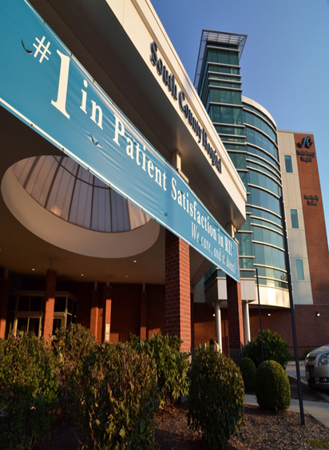
Washington County – Dr. Bandola Medical Director and PCP Dr. Drury Emergency Room Physician Dr. Hao Huang- Medical Director SCNC Dr. Rubenstein-Director of Hospitalists Dr. William Sabina- Director, Medical Staff and Medical Director, Emergency room South County Hospital Bright View Commons South County Homecare Scallop Shell South County Nursing and Rehab South Kingstown Nursing and Rehab Roberts Health Centre Apple Clipper Brookdale Assisted Living Westerly Health Center Apple Watch Hill Manor The Westerly Hospital Hospice-Home and Hospice of RI &Gentiva Hospice Care Managers PCMH Health centric Advisors
Notes:
Who is at the Table 2 Hospitals 7 Rehabs 2 Assisted livings 3Homecare 3 Hospices 5 Care Managers Medical Directors/DONs of the facilities Pharmacists Infectious disease Recreational service coordinator for low income housing Behavioral health specialists QIN-QIO

Slide 3
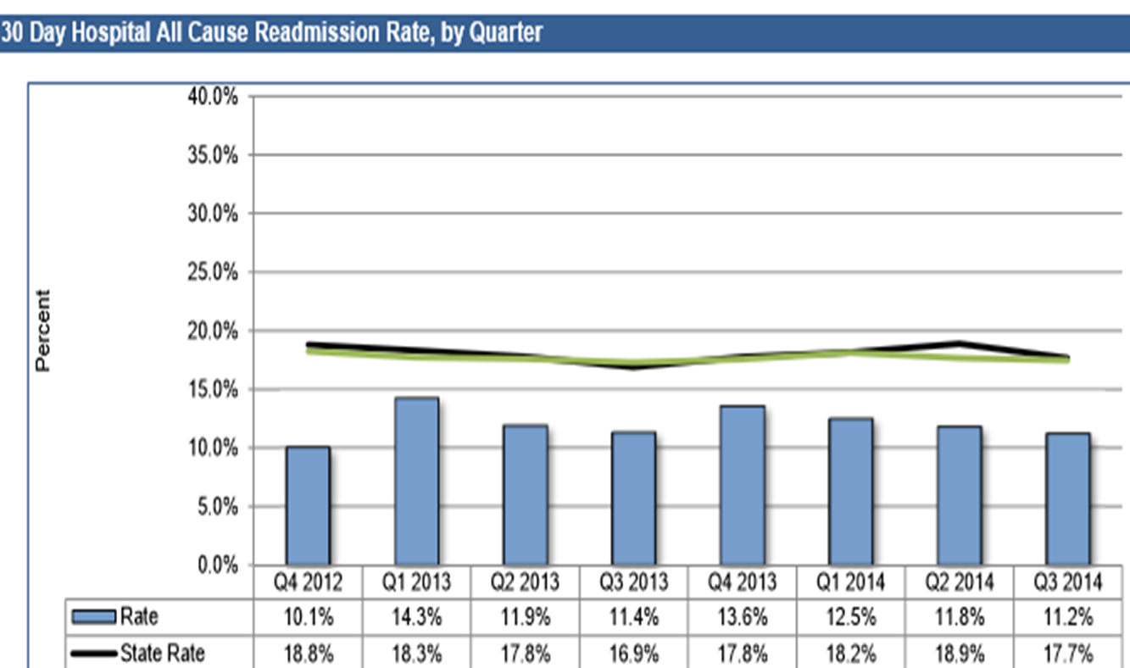
Medicare Readmissions Data
Lowest readmission rate in the state
Medicare Readmissions Data

Slide 4
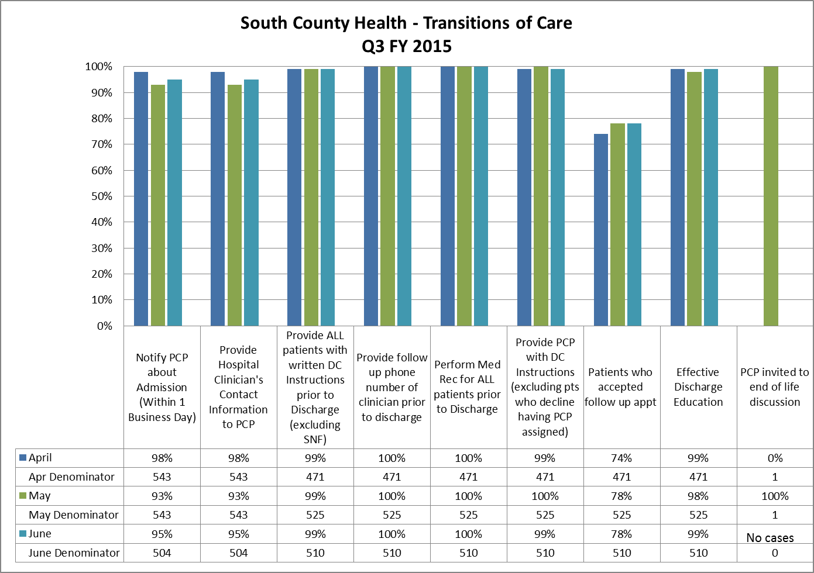

Slide 5
Medication Management
Complete and accurate
Nurse hand-off
Fax prescription to SNF pharmacy
Business plan to SLT for support of increasing pharmacy resources
Transfer of information
Pre-medication
Completeness of orders
Pharmacy completing admission and discharge medication reconciliation

Slide 6
University of Rhode Island
PharmD students completing medication reconciliation in the ED
Residency program set up to yearly projects
PharmD student completing rotation with homecare- joint visit with RN
PharmD students rotation in SNFs
Notes:
40% patients touched as inpatient just added 1 FTE to increase to goal of 90%
Yearly projects such as improvement of pain,
Students starting in the hospital seeing patients here than out in the home. Much variation.
PharmD in SNF business plan for staff pharmastist in the SNF/LTC decreased mthly cost by around 20,000.00

Slide 7
EMR
Started in the paper discharge
Updated to electronic
Improved legibility
Identified opportunity
Faxed discharged to SNF, Homecare and PCP prior to discharge
Starting to share EMRs with SNF and Homecare
Notes:
Electronic discharge postponed related to inefficiencies.

Slide 8
Medication Management Behavioral Health Infectious disease Education Insurance Sharing IT URI College of Pharmacy
Notes:
Medication management- established free MTM program for the community, increased FTE for in patient pharmacy staff. Started electronic discharge process faxed prescriptions prior to discharge shared medication data during RN to RN report. Trialing Discharge Time out for review of medication reconciliation. SNF brown bag program add pharmacy to SNF for medication review reduced usage by 10,000-20,000/ per mth. Behavioral health to SNF most have contract SCH developed Community Health Team. Codac visit to collaborate with SNF patients. ID for procedural opportunities. Improvements with transfer of information. SNF staff invited and participate with patient education committee. Assist with OBS coverage for reduction to patients. Sharing HIPPA compliant IT. Sharing Pharm D students with all settings.

Slide 9
Nurse Care Managers Patient Center Medical Home
Bring people together
Team- Multidisciplinary team of the hospital, NCM of the PCMH, SNF, Homecare, Hospice, Community Health Team.
Communication and transparency is key to opportunity and improvement

Slide 10
Examples: The Quahogger: 85 year-old gentleman who is a “Quahogger” with HF refused VNS at discharge When readmitted, SCHHS used a systematic approach VNS created a reimbursement code to provide services to non-homebound patients Patient was initially non-compliant with his own priorities Patient was a role model for HF self management

