Slide 1
The San Diego care transitions partnership
Transforming Care Across the Continuum
Brenda Schmitthenner, MPA
County of San Diego
Aging & Independence Services

Slide 2
Community-Based Care Transitions program (CCTP)
Section 3026 of the ACA
Reduce all-cause, 30-day readmissions for fee-for-service (FFS) Medicare patients by 20%
Reduce readmissions for high-risk patients
Reduce Medicare spending
Test models for improving care
Links Community-Based Organizations to hospitals
San Diego Care Transition Partnership (SDCTP)
Partnership between County of San Diego and 11 hospitals
Largest CCTP in the country
Coordinating care across settings
2

Slide 3
San Diego Care Transitions Partnership (SDCTP)
Great Opportunity for San Diego County
Demonstrate to the rest of the country how to:
Design and implement a patient-centered system of care
Scale up a comprehensive care transitions program
Test new care transition interventions and share data and best practices
Improve the health of the community
Innovate with clinical and social service partners

Slide 4
San Diego Care Transitions Partnership (SDCTP)
The SDCTP Care Transitions Program Design
Patients receive specific care transition services tailored to their individual needs:
In-patient nursing support
Medication reconciliation and education
Care Transitions Intervention (CTI)
Care Enhancement (CE)
Telephonic CTI
Follow-up Phone Calls

Slide 5
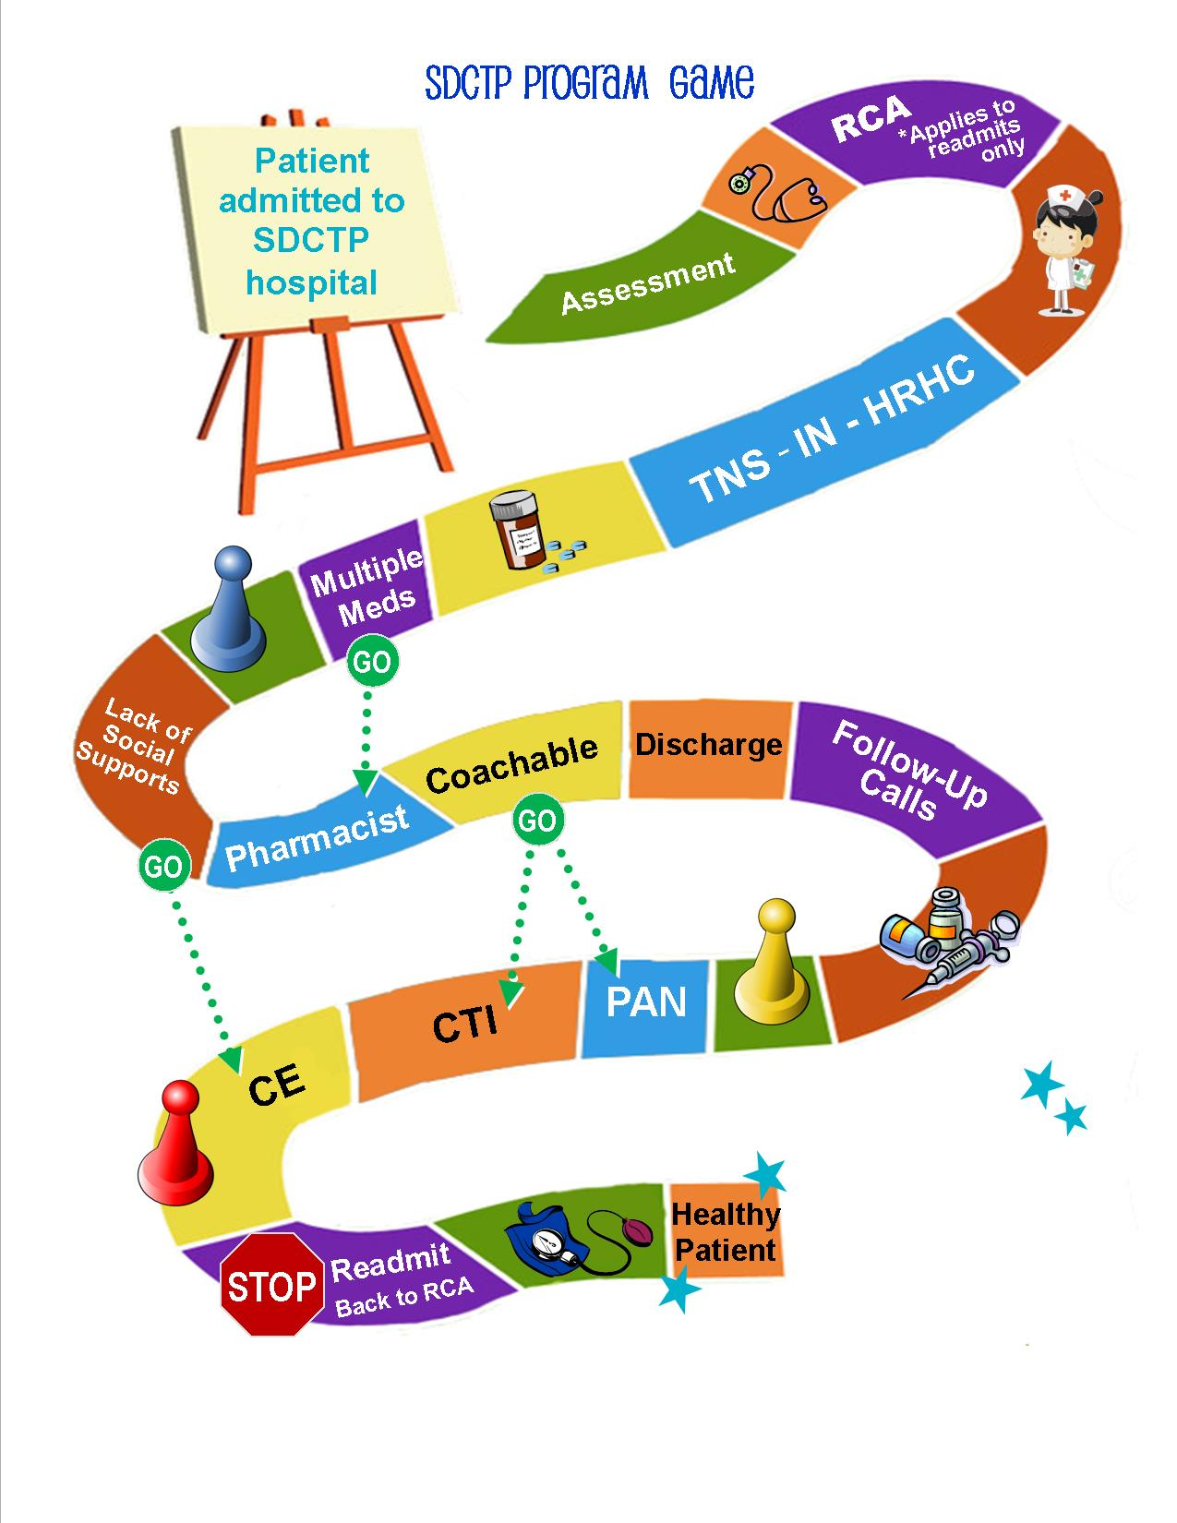
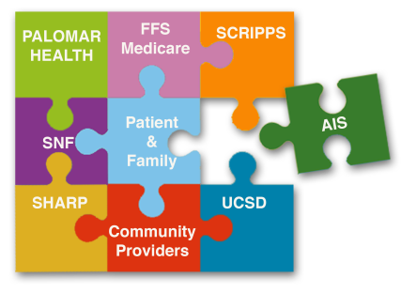
San Diego Care Transitions Partnership (SDCTP)
The SDCTP in Action
*RCA = Root Cause Analysis
*TNS = Transitions Nurse Specialist
*IN = Inpatient Navigator
*HRHC = High-Risk Healthcare Coach
*CE = Care Enhancement
*CTI = Care Transitions Intervention
*PAN = Post-Acute Navigation

Slide 6
San Diego Care Transitions Partnership (SDCTP)
Accomplishments
January 2013 to January 2015
13.4% estimated readmission rate
66.3% less than the SDCTP’s 2012 Target Group baseline.
13.4%
1,281 prevented 30-day readmissions for CCTP participants.
$13,163 average readmission cost in San Diego County
$7.2M overall Medicare savings
$50M decrease in Medicare spending
Target Group baseline: CCTP participants 30 day readmission rate from 2012
CCTP Participants: Those who completed services (CCTP Completers) and those who did not complete all aspects of the program

Slide 7
San Diego Care Transitions Partnership (SDCTP)
Coming together is a beginning
Keeping together is progress
Working together is success
- Henry Ford

